Slide 1


Using Machine Learning Algorithm to Predict Death of Heart Failure Patients
Group IDEA
Wu Jingyi
Lei Sijie
Liu Peilin

Slide 2

1
Introduction
2
Data Preparation
Agenda
3
Setting up Models & Tuning
4
Application
5
Conclusion

Slide 3

1
Introduction

Slide 4

Heart Failure & Sudden Death or Low Survival Possibility
65 Million Americans suffer
Notes:
Heart failure ->sudden death or low survival possibility
in a short period of time.
Nowadays, heart failure is very common and has gradually become the main reason for the increase in morbidity and mortality worldwide.
research show-> More than 6.5 million Americans are now living with heart failure (HF) and the prevalence continues to increase.
Due to an aging population(China, Singapore and so on), this disease and its complications appear more and more frequently in aging patients.
Therefore, research on the application of machine learning algorithms in this disease prediction will be of great significance.

Slide 5
Factors Cause Heart Failure
Arrhythmias（心律不齐）
Age
Gender
Ethnic groups
Blood level
Smoking habits
Notes:
Many studies have shown some factors that may cause heart failure (HF).
One of these factors is arrhythmias(心律不齐), a common belief as the main culprit prevails.
In addition, higher risk of HF occurrence also goes hand in hand with some certain demographic features, such as age, gender, ethnic groups, blood level and smoking habits.
It seems that patients who are elderly, women, American African with uncontrolled blood pressure and heavy smoking habits are more likely to contract HF.

Slide 6
Treatments of Heart Failure
Pharmacological treatment
vasodilator treatment
(血管扩张)
Non-Pharmacological treatment
implantable defibrillator(去纤颤器)
Heart
Failure
Vital to save& prolong life
Medical resources distribution
High risk-> earlier& intensive monitor& medical care
Notes:
From a therapeutic perspective, many studies introduced and analyzed effective treatments for this disease
pharmacological treatment such as vasodilator treatment （血管扩张）and non-pharmacological treatment such as implantable defibrillator（去纤颤器） will, to some extent, slower the Death’s chase.
But the truth is there are few studies on how to predict the susceptible population of this disease or how to identify high-risk patients with HF.
So predicting is necessary but challenging.
Since diagnosed HF patients are walking the verge of life-and-death every day, it will be an especially vital subject to know how to draw implications through monitoring their vital indicators to prolong their life.
“Predicting adverse outcomes in patients with HF could help allocate resources to appropriate patients
To the high risk patients, more earlier and more intensive monitoring and medical care should distributed to them( medical care such as e.g. targeted medications, cardiac devices, home monitoring systems, and social services), while to the low risk patients, we may avoid unnecessary interventions and costs for them

Slide 7

2
Data Preparation

Slide 8
Data Description
Data Source: https://www.kaggle.com/andrewmvd/heart-failure-clinical-data.
12
299 samples
Features
DEATH_EVENT:
“1” dead
“0”survived
1
Label

Slide 9
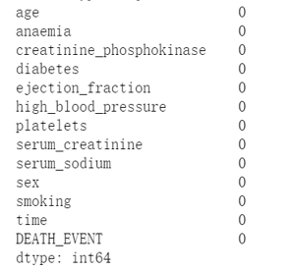
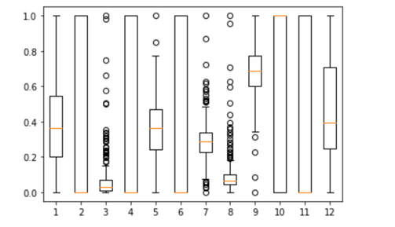
No missing values
No outliers

Slide 10
Understanding the Features
1
age
2
Anaemia(贫血)
3
creatinine_phosphokinase
(肌酸磷酸激酶)
Features
4
diabetes
5
ejection_fraction(射血分数)
6
high_blood_pressure
Notes:
Anaemia: (贫血)
creatinine_phosphokinase (肌酸磷酸激酶)- enzyme in the blood (mcg/L)是一个与细胞内能量运转、肌肉收缩、ATP再生有直接关系的重要激酶。肌酸激酶活性测定可以用于骨骼肌疾病及心肌疾病的诊断。
ejection_fraction-射血分数指每搏输出量占心室舒张末期容积量（即心脏前负荷）的百分比，正常值为50-70%，可通过心脏彩超进行检查，是判断心力衰竭类型的重要指征之一

Slide 11
Understanding the Features
7
platelets(血小板)
8
serum_creatinine(血清肌酸酐)
9
serum_sodium(血清钠)
Features
10
sex
11
smoking
12
time
Notes:
serum_creatinine(血清肌酸酐)
临床上检测血肌酐是了解肾功能的主要方法之一，是肾脏功能的重要指标，血清肌酐升高意味着肾功能的损害。

Slide 12
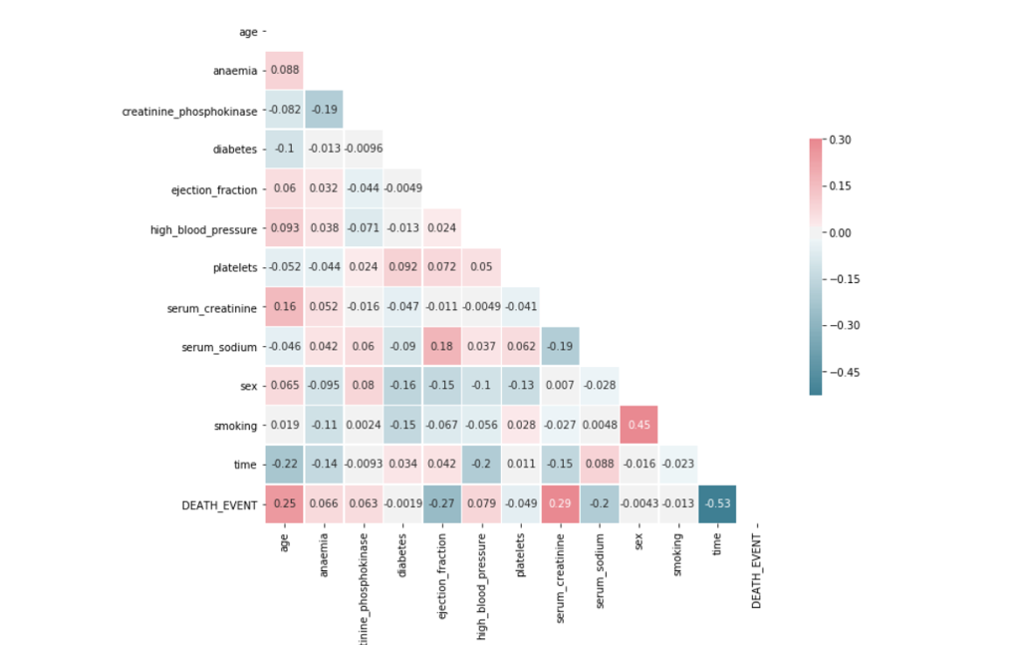
Correlation Matrix
The features do not have a strong auto-correlation with each other except age and smoking with correlation coefficient 0.45.

Slide 13
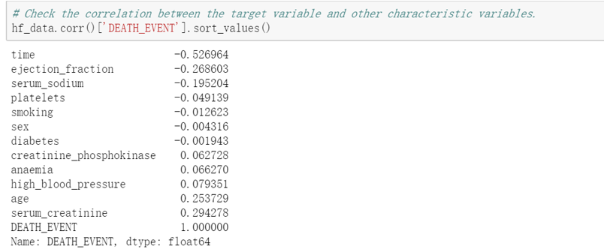
Correlation Coefficient
The four most relevant features with DEATH_EVENT is “time”, “serum_creatinine”, “ejection_fraction” and “age”.

Slide 14
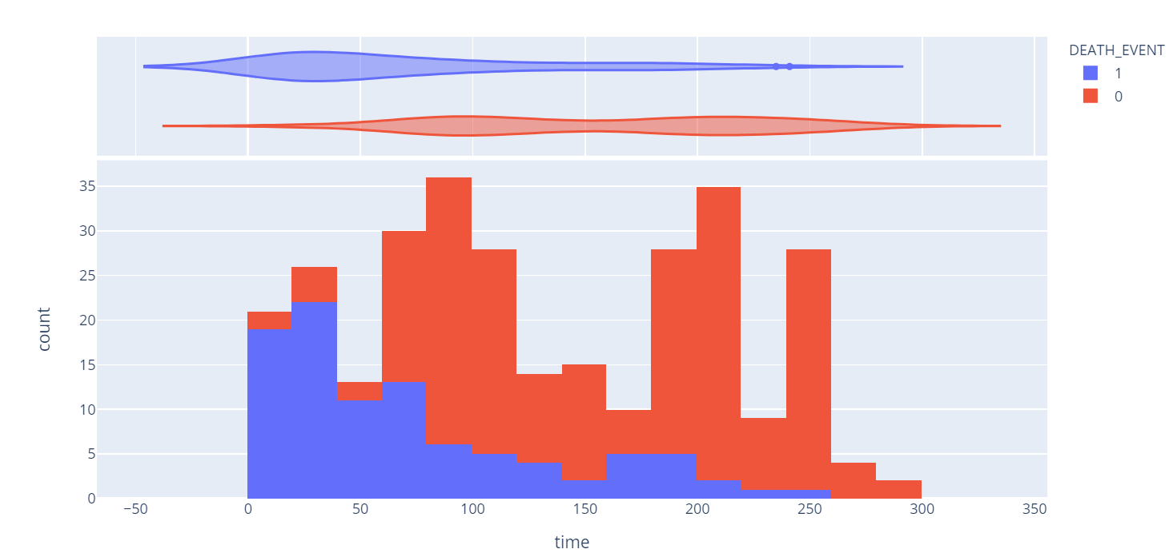
Relationship between “time”&“DEATH_EVENT”
Range: 4-285
Critical: the first 75 days following HF

Slide 15
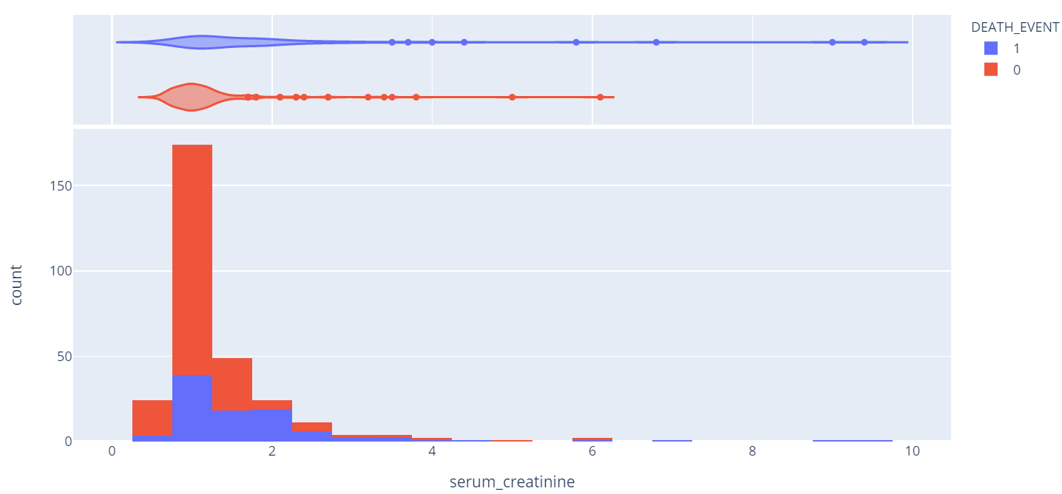
Relationship between “serum_creatinine”(血清肌酸酐) &“DEATH_EVENT ”
>133 μmol/L-> renal disorder/ renal failure(肾衰竭)
Average 1.39 mg/dLvs. Normal (0.84 ~1.21 mg/dL)

Slide 16
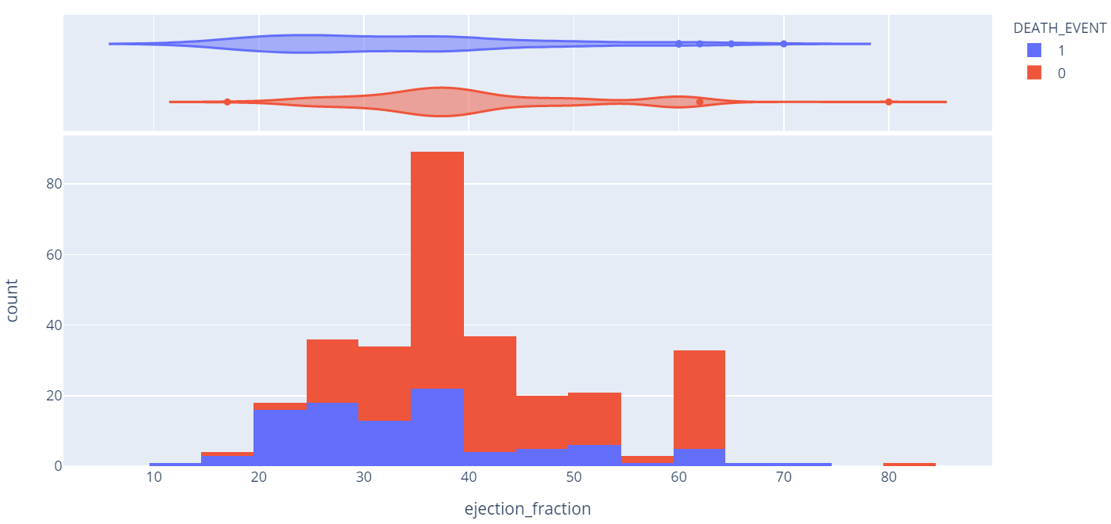
Relationship between “ejection_fraction” ”(射血分数) &“DEATH_EVENT ”
Normal: left ventricular >=50%, right >=40%

Slide 17
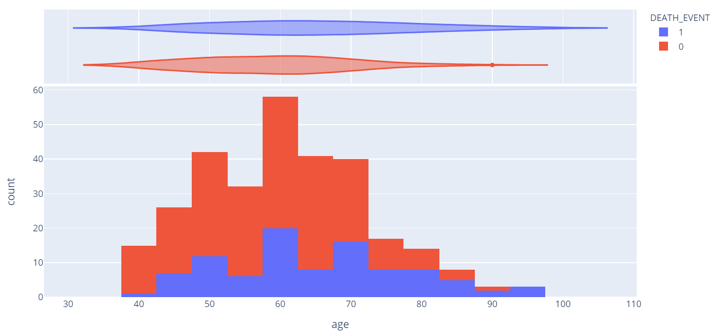
Relationship between “age”&“DEATH_EVENT ”
Range: 40~95
60s: 50%; 75s:75%

Slide 18
Training and Testing Data Split
Total 299 samples
80/20
239 training data
60 testing data

Slide 19

3
Setting up Models & Tuning

Slide 20
All the models we set up
Ensemble models
XGB Classifier
SVM
AdaBoost
Gradient Boosting
Decision Tree
Random Forest
Logistic Regression

Slide 21
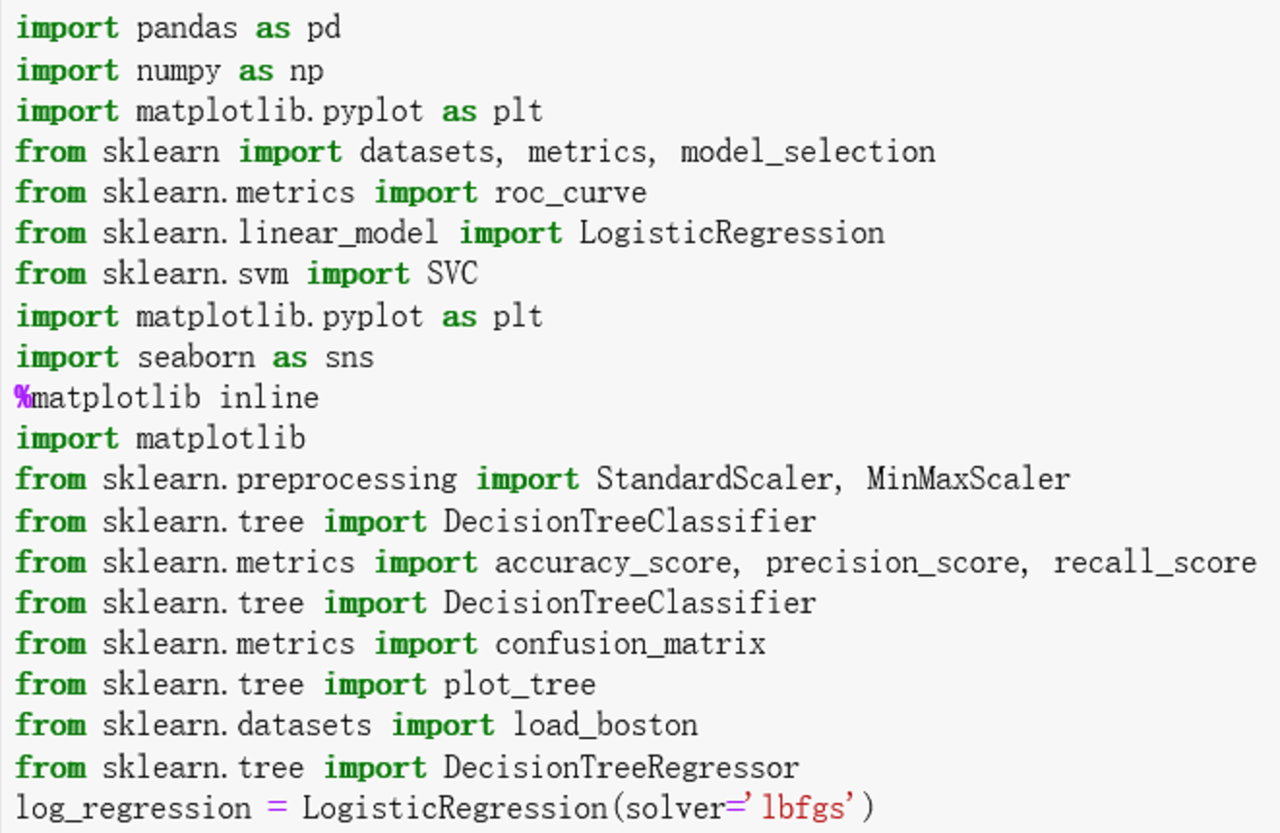
All the packages we used

Slide 22
Model Comparison
We used binary classifiers to set up the model and predicted life-or-death problem about heart failure.
Considering both F1 and accuracy score, Logistic Regression, SVM and Random Forest are selected.
We mainly focused on these three models to do Parameters Tuning & Feature Selecting

Slide 23
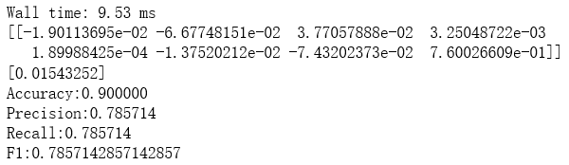
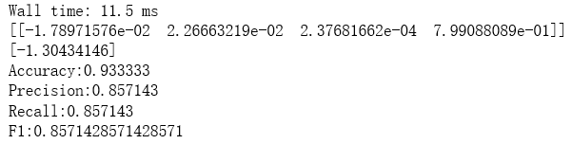
Logistic Regression
Drop features with low correlation coefficient
Train/test the model and do evaluation
Reduce features and choose the final model
Mainly focus on F1 and accuracy score

Slide 24
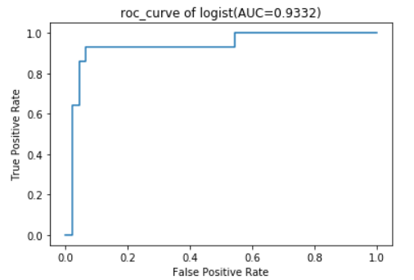
Logistic Regression
Scores | Model 1 | Model 2
accuracy | 0.90 | 0.93
precision | 0.78 | 0.85
recall | 0.78 | 0.85
F1 | 0.78 | 0.85
The role of feature selection:
reduce computational cost and improve classification performance.

Slide 25
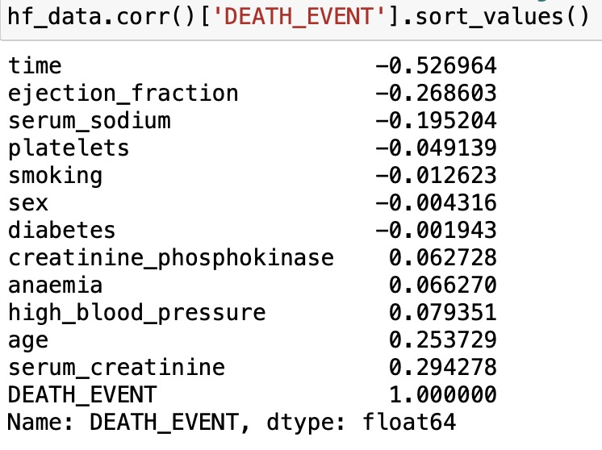
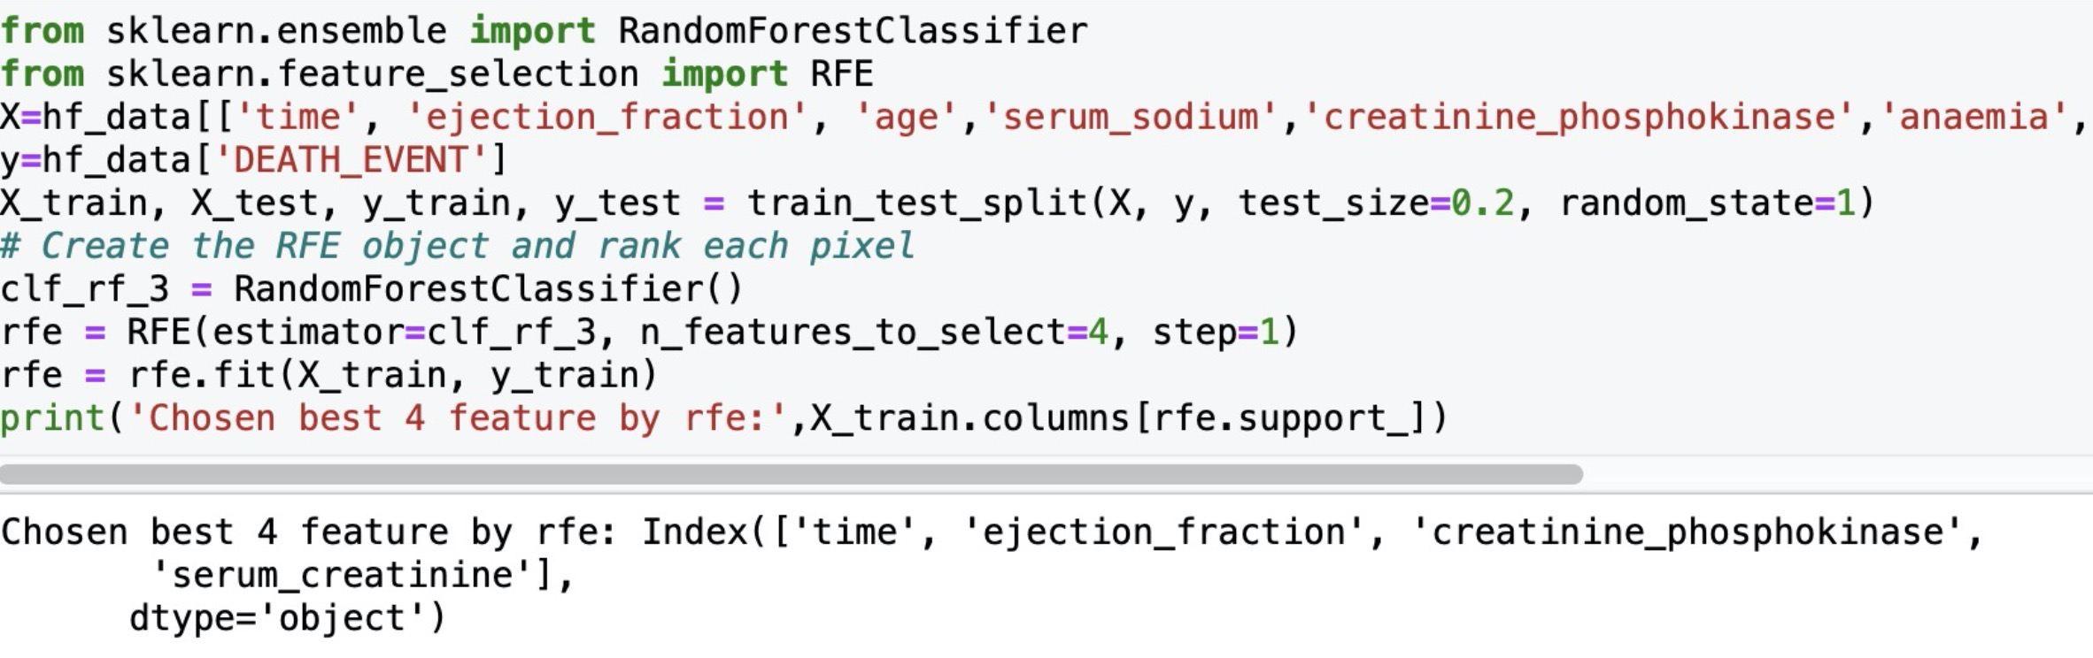

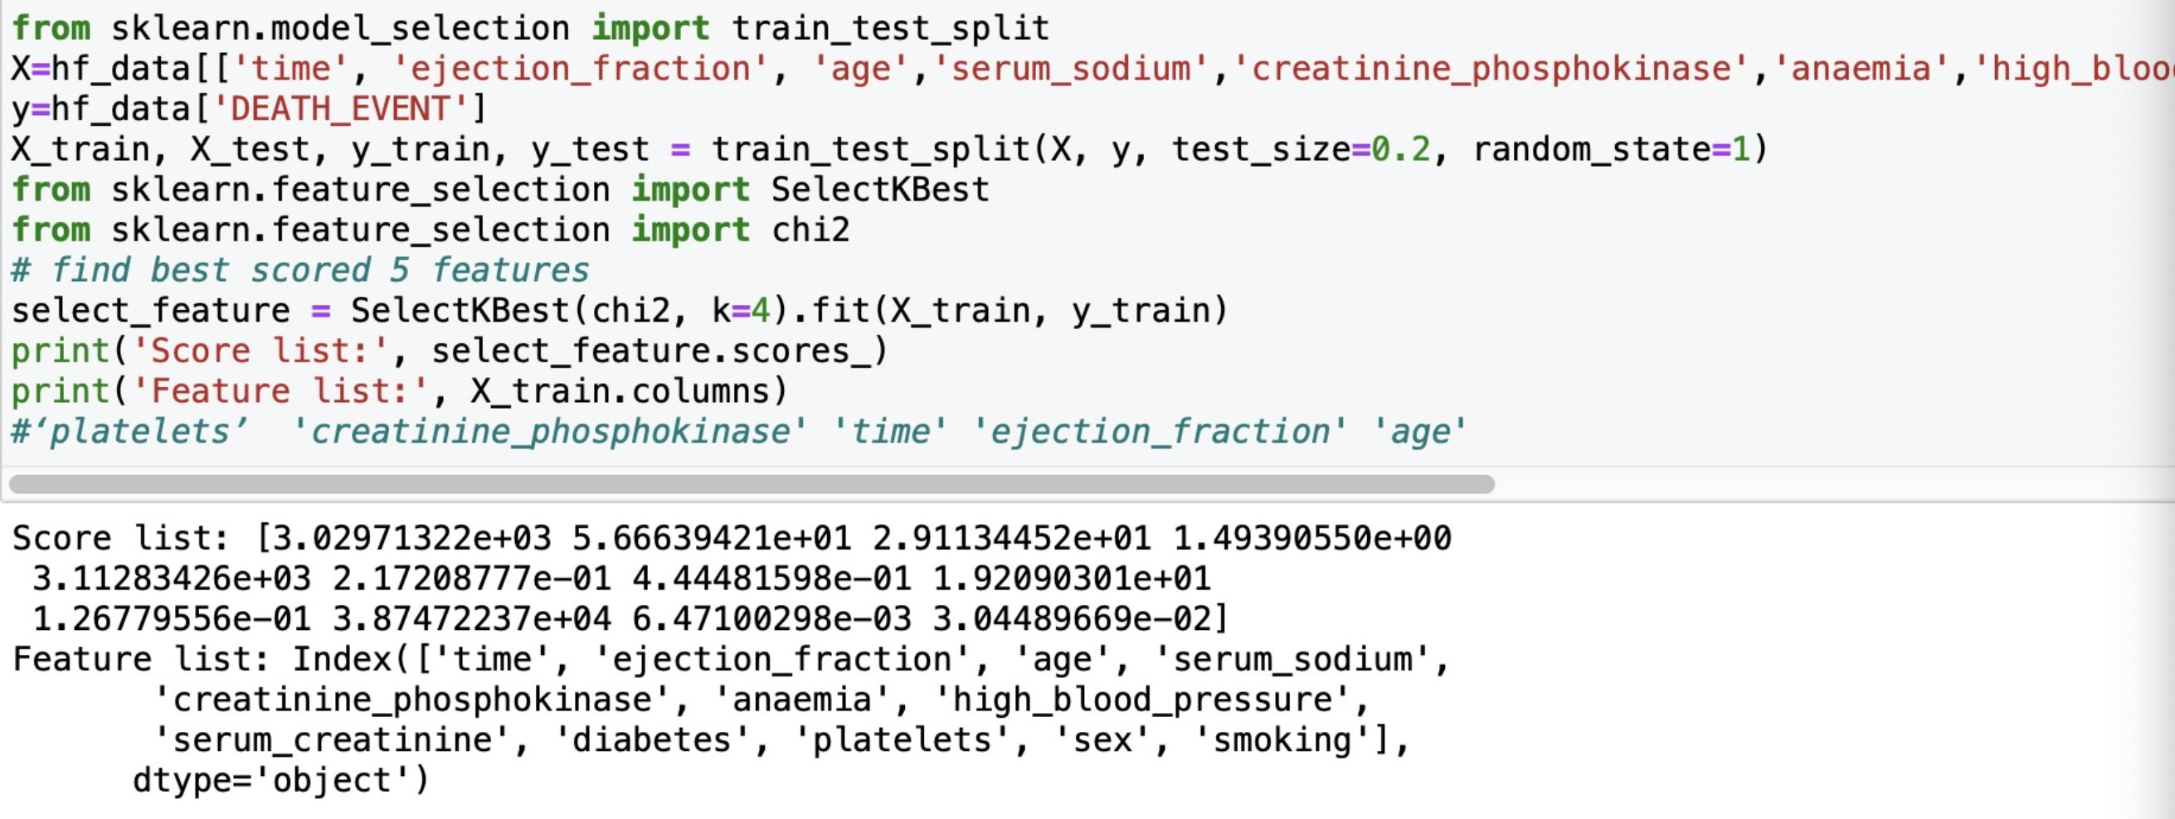
SVM – Feature Selection
① Correlation
② RFE with RandomForest
③Univariate feature selection

Slide 26
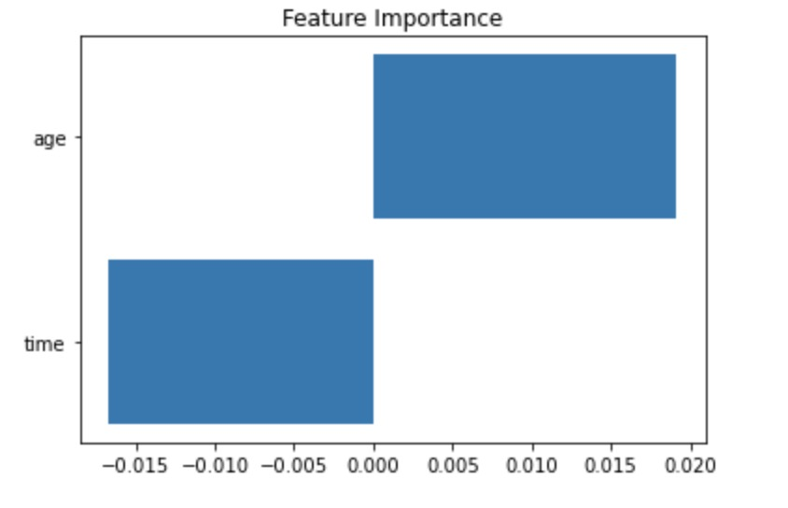
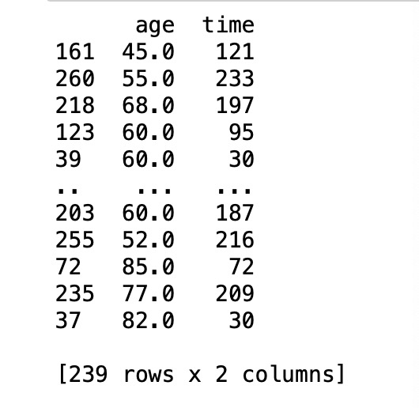
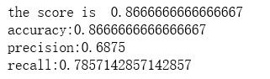
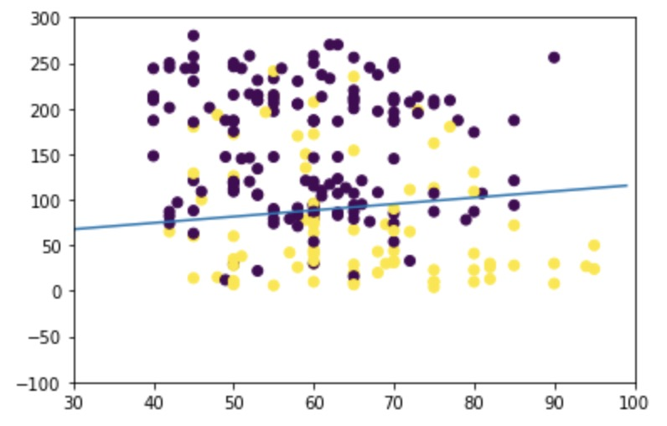
SVM – Feature Selection(2 features)
evaluation

Slide 27
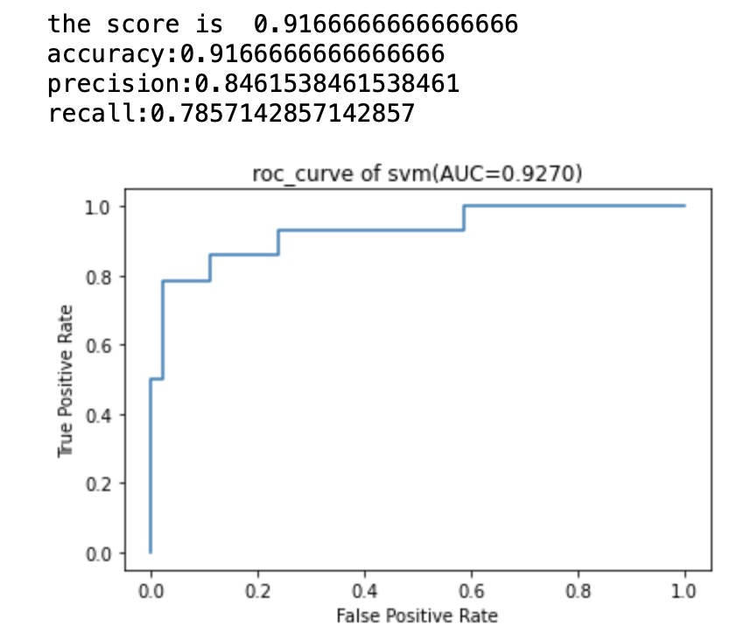
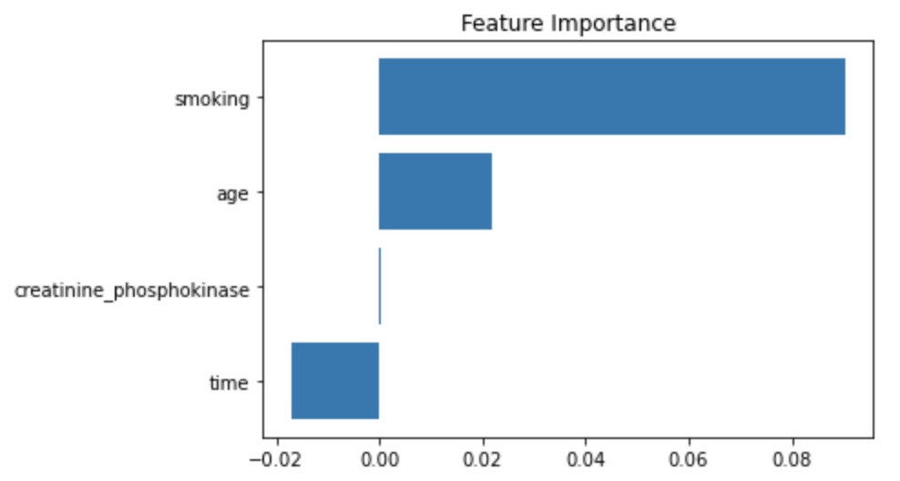
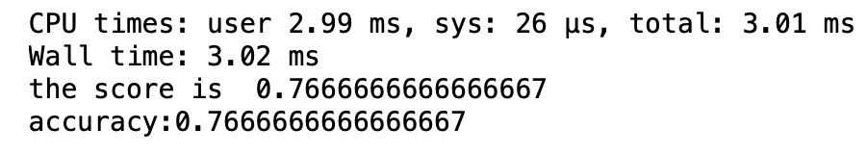
SVM – Feature Selection(4 features)
Using linear model
Using non-linear model
faster but low accuracy

Slide 28
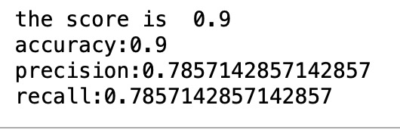
If we add more features ?
add to 8 features
The score will drop when adding to 8 features.

Slide 29
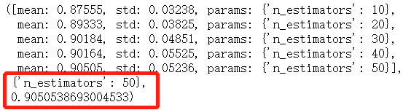

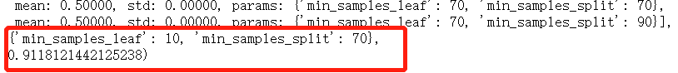
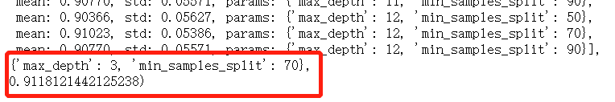
Random Forest Tuning
Parameters: n_estimators
max_depth
min_samples_split
min_samples_leaf
Scores | Forest 1 | Forest 2
accuracy | 0.88 | 0.91
precision | 0.81 | 0.83
recall | 0.64 | 0.71
F1 | 0.72 | 0.77

Slide 30

4
Results Comparison
1. Performance Test
2. Input Simulation

Slide 31
Performance Test
Previous result
Models | Wall-time | Accuracy | Precision | Recall | F1
Logistic Regression | 40.9ms | 0.9000 | 0.7857 | 0.7857 | 0.7857
SVM | 256ms | 0.8667 | 0.6875 | 0.7857 | 0.7333
Decision Tree | 2.31ms | 0.7500 | 0.7500 | 0.6000 | 0.6666
Random Forest | 50.8ms | 0.8833 | 0.8181 | 0.6428 | 0.7200
AdaBoost | 329ms | 0.8500 | 0.6470 | 0.7857 | 0.7097
Gradient Boosting | 263ms | 0.8333 | 0.6111 | 0.7857 | 0.6875
XGB Classifier | 128ms | 0.8667 | 0.6875 | 0.7857 | 0.7333
After tuning
Current result
Models | Wall-time | Accuracy | Precision | Recall | F1
Logistic Regression | 7.98ms | 0.9333 | 0.8571 | 0.8571 | 0.8571
SVM | 1min43 | 0.9166 | 0.8461 | 0.7857 | 0.8148
Decision Tree | 2.31ms | 0.7500 | 0.7500 | 0.6000 | 0.6666
Random Forest | 251ms | 0.9 | 0.8333 | 0.7143 | 0.7692
AdaBoost | 329ms | 0.8500 | 0.6470 | 0.7857 | 0.7097
Gradient Boosting | 263ms | 0.8333 | 0.6111 | 0.7857 | 0.6875
XGB Classifier | 128ms | 0.8667 | 0.6875 | 0.7857 | 0.7333

Slide 32
Result Visualization

Slide 33
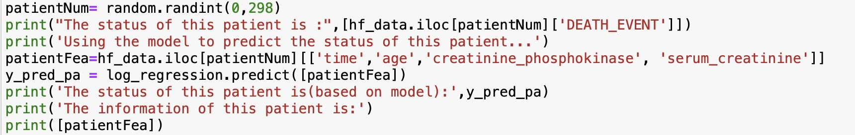
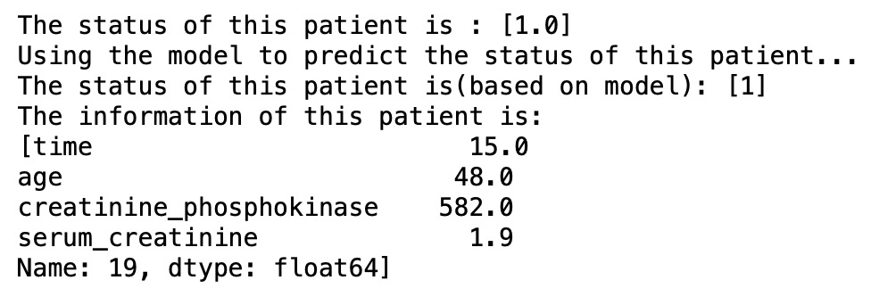
Input Simulation
Two ways to do the simulations.
1.Random select
Results

Slide 34
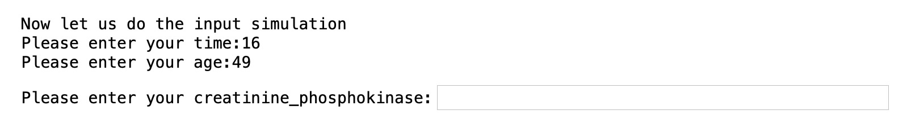
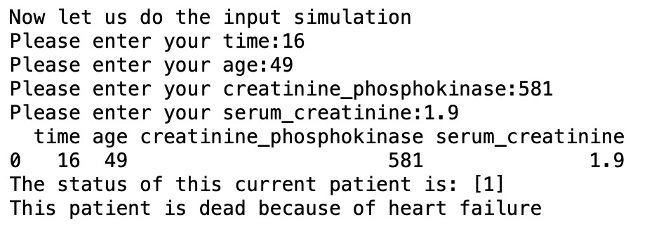
Input Simulation
2. Input information
Results

Slide 35

5
Conclusion& Limitation

Slide 36
Conclusion
After tuning, the best three models are Logistic Regression, SVM, Random Forest.
1. The wall time is 7.98ms.
2. F1 score could achieve at 0.8571. The accuracy could achieve at 0.9333.
Based on these statistics, Logistic Regression could have higher score in performance and lower running time.
Input simulation
1. Random select.
2. User input.

Slide 37
Limitation
1. Best features are not generated from machines. Features with high correlation coefficients cannot achieve better performance.
2. Because of the limitations in technical skills, we couldn't adjust the better parameters in model optimization.
3.The data base is not big enough.
Expectation
1. Gather more data and do futher optimization in different kinds of models.

Slide 38

Thank you！

